Slide 1
Sentiment Analysis in Popular Song lyrics Over time
Simon Johnston
16-Feb-2023

Slide 2
About ME
B.Eng Chemical Engineering
8 yrs experience designing manufacturing processes for medical devices and pharmaceuticals
Why Data Science?
It’s a great tool for the tool-belt when identifying problems and creating impactful solutions

Slide 3
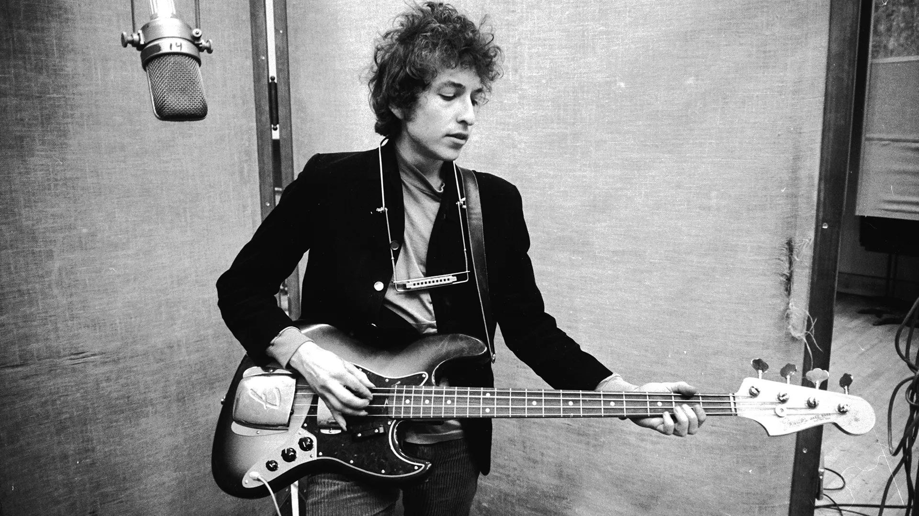
Introduction
“The times they are a-changing”
Bob Dylan
“What would a computer know about music?
Probably nothing.”
Not Bob Dylan
Notes:
- I have always been interested in music from a historical perspective. I think looking at music through the years is a great way to understand or assess what the culture of a given time and place was like, or what the outlook of the listeners of that music was like at the time.
-

Slide 4
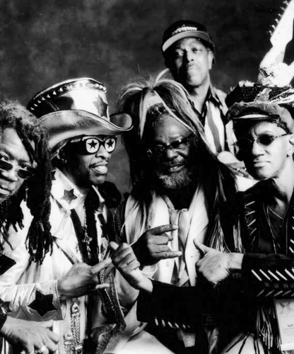
Problem Statement: As a listener it is difficult to objectively measure how the sentiment in popular music has changed over a large sample space. Solution: Use NLP to measure how sentiment has evolved over time. Limitation: Lyrical sentiment is only one element of the overall sentiment in a song.
Introduction

Slide 5
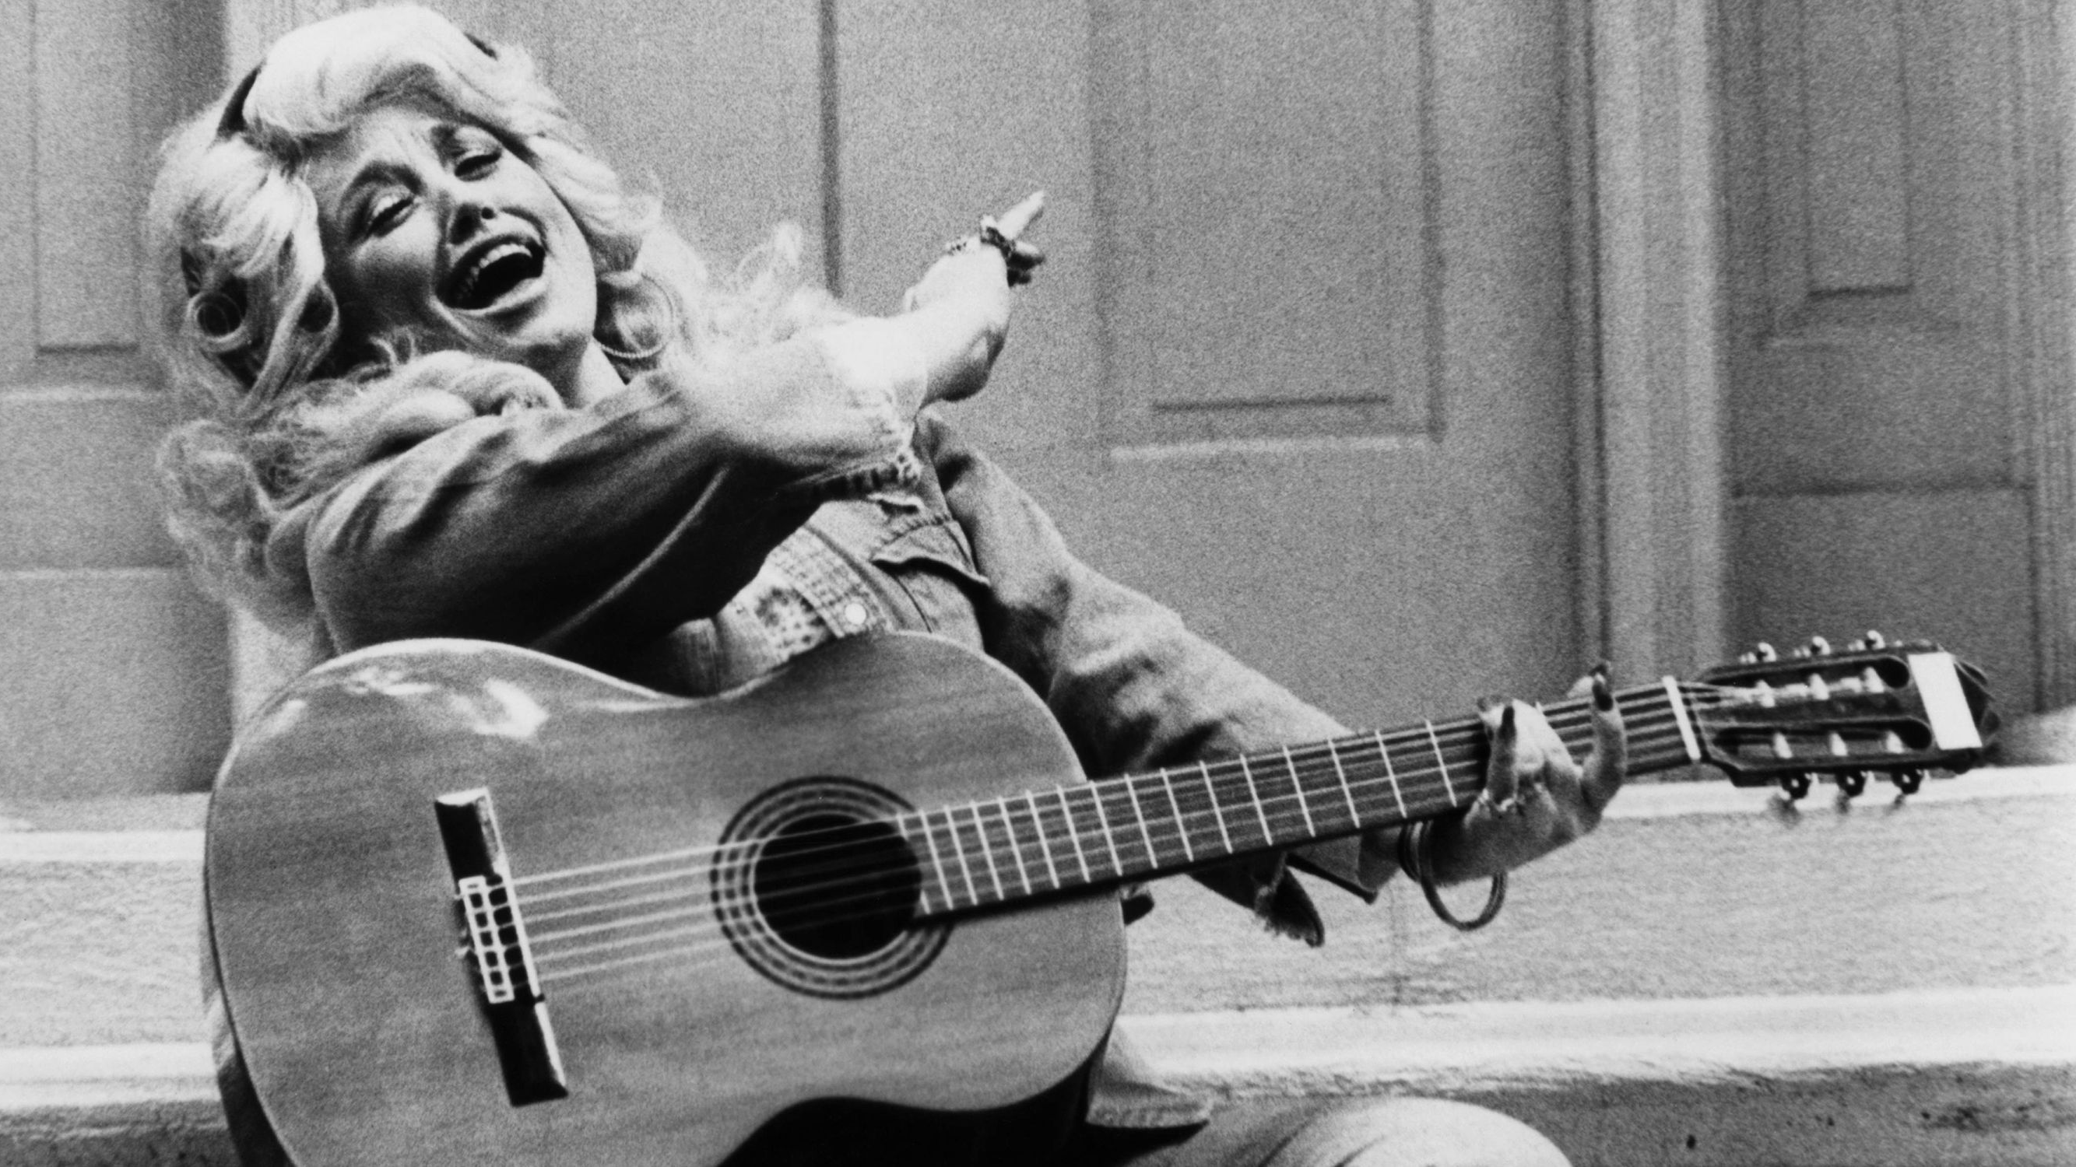
Definitions and Data
Definitions:
POPULAR: Most consumed music, as defined by the Billboard Top 100
SENTIMENT: Negative, Neutral, Positive
Data:
Popular Songs: Billboard Top 100
Weekly chart from 1958 – Today (300K Songs)
Lyrics:
Genius API
Song Metadata:
Spotify APIs
Model Selection:
Baseline: NLTK Vader
Final: Hugging Face ROBERTA Twitter Sentiment

Slide 6
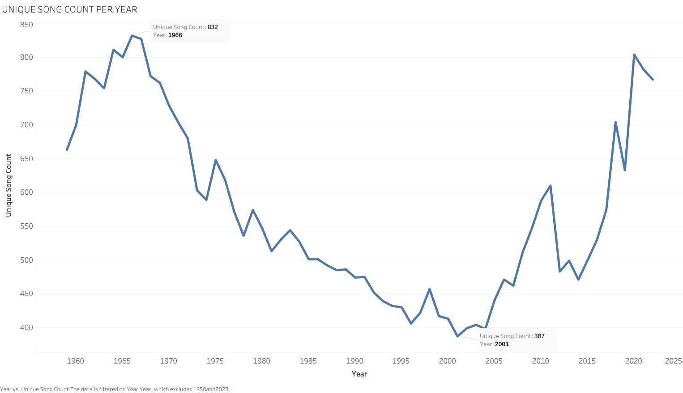
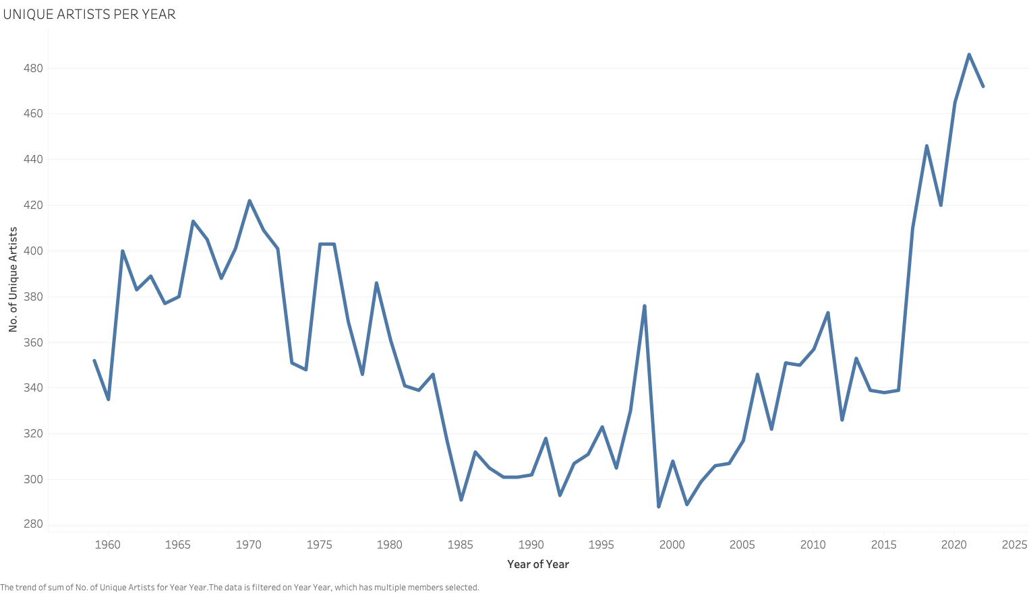
EDA Insights
Notes:
There is not a ton of time so I will pull out just one point that was interesting from the EDA,
Bathtub shape

Slide 7
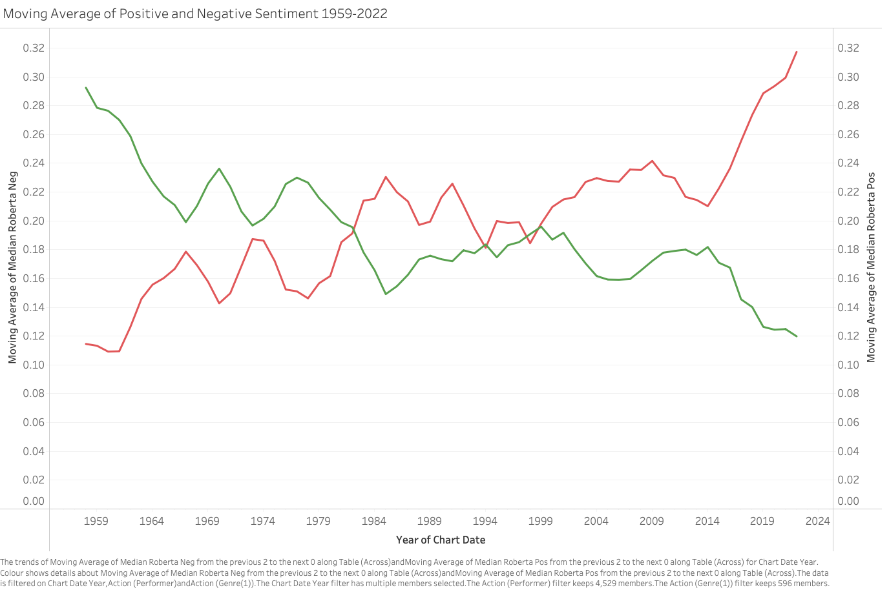
Results – ROBERTA Model
Lyrically, songs are getting more negative over time
Average of 3.3% increase in negativity per decade
Challenges:
Understanding how
Hypothesis:
Tolerance of explicit content has increased
Emergence of new genres. E.g. nu-metal, hip-hop
Next steps:
Include audio metadata
Cluster genres and investigate the prevalence of genres over time
Decade Comparison | 2 Sample Z-Test (P Value) | Statistically Significant Change?
60s – 70s | 0.007 | Yes
70s – 80s | 0.09 | No
80s – 90s | 0.03 | Yes
90s – 2000s | 0.15 | No
2000s – 2010s | 0.51 | No
2010s - 2020s | 6 x 10⁻¹¹ | Yes

Slide 8




Thank you
Simon Johnston
simon.johnston.work@gmail.com

Slide 9

Next Steps
Understand how sentiment has changed within genres.
Investigate the trends in audio metadata

Slide 10
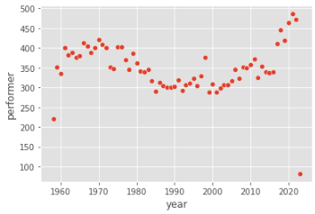
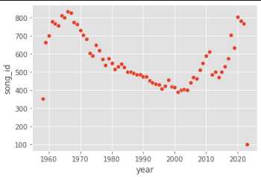
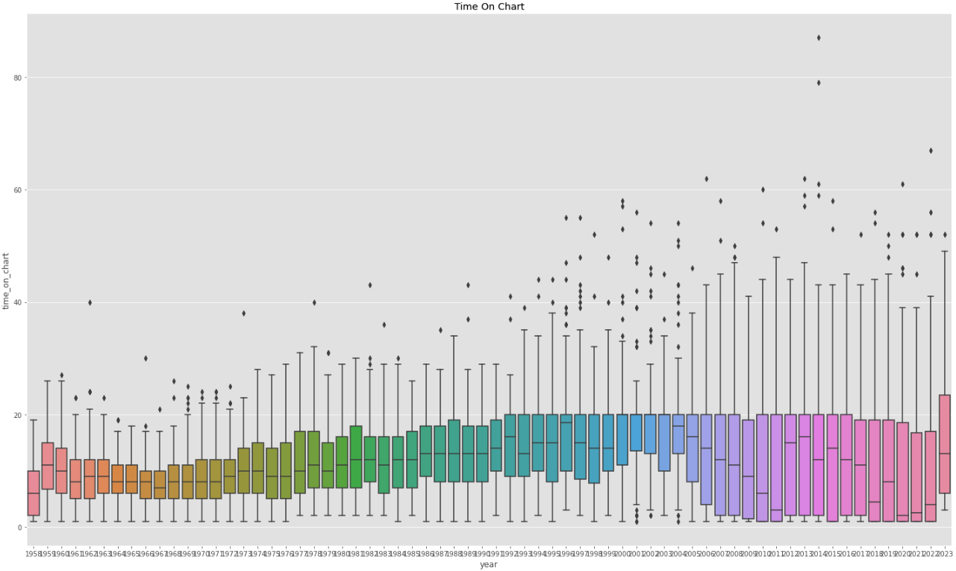
EDA – Insights

Slide 11
Results – Dashboard

